Slide 1
Parallel and Distributed Computing
CS3006
Lecture 7
Mapping Schemes
14th March 2022
Dr. Rana Asif Rehman

Slide 2
Agenda
A Quick Review
Decomposition Techniques
Distribution Schemes
Block-distribution
Row-wise
Column-wise
1D and 2D
Cyclic and Block-cyclic

Slide 3
Mapping Schemes
Static Mapping
Distributing the tasks among the processes before execution of the program
E.g., usually used in situation where total number of tasks and their sizes are known before the execution of the program
Easy to implement in massage passing paradigm
Dynamic Mapping
When total number of tasks are not known a priori
(OR) when task sizes are unknown
In this case static mapping can lead to serious load-imbalances.
Both static and Dynamic Mappings are equally easy in shared memory paradigm
Notes:
Objective is to minimize amount of interaction and idling.

Slide 4
Schemes for Static Task-Process Mapping (Mappings based on Data Partitioning )
Array Distribution Schemes
In a decomposition based on partitioning data, mapping the relevant data onto the processes is equivalent to mapping tasks onto processes *
Commonly used array mapping schemes:
Block distribution
1D and 2D
Cyclic and block-cyclic distribution
Notes:
As tasks and processes are closely related with owner compute rule.
If we know the size of tasks, size of data associated with each task, programming paradigm and characteristics of inter task interactions; then we should go for static mapping

Slide 5
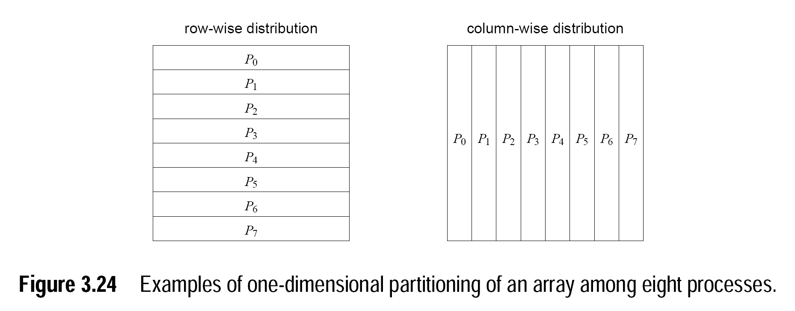
Schemes for Static Mapping (Mappings based on Data Partitioning )
Array Distribution Schemes:
Block distribution (1D)
Notes:
2d array---n/p rows as blocks and n/p column as block
Row major order vs column major order

Slide 6
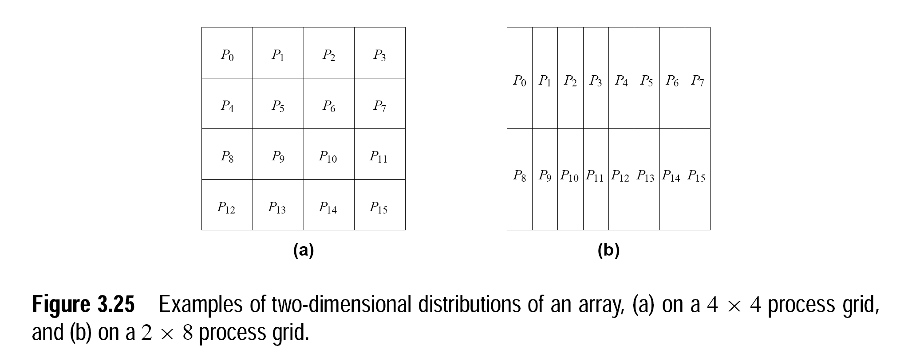
Schemes for Static Mapping (Mappings based on Data Partitioning )
Array Distribution Schemes:
Block distribution (2D)
Notes:
P=p1*p2-----and each chunk of n/p1 * n/p2

Slide 7
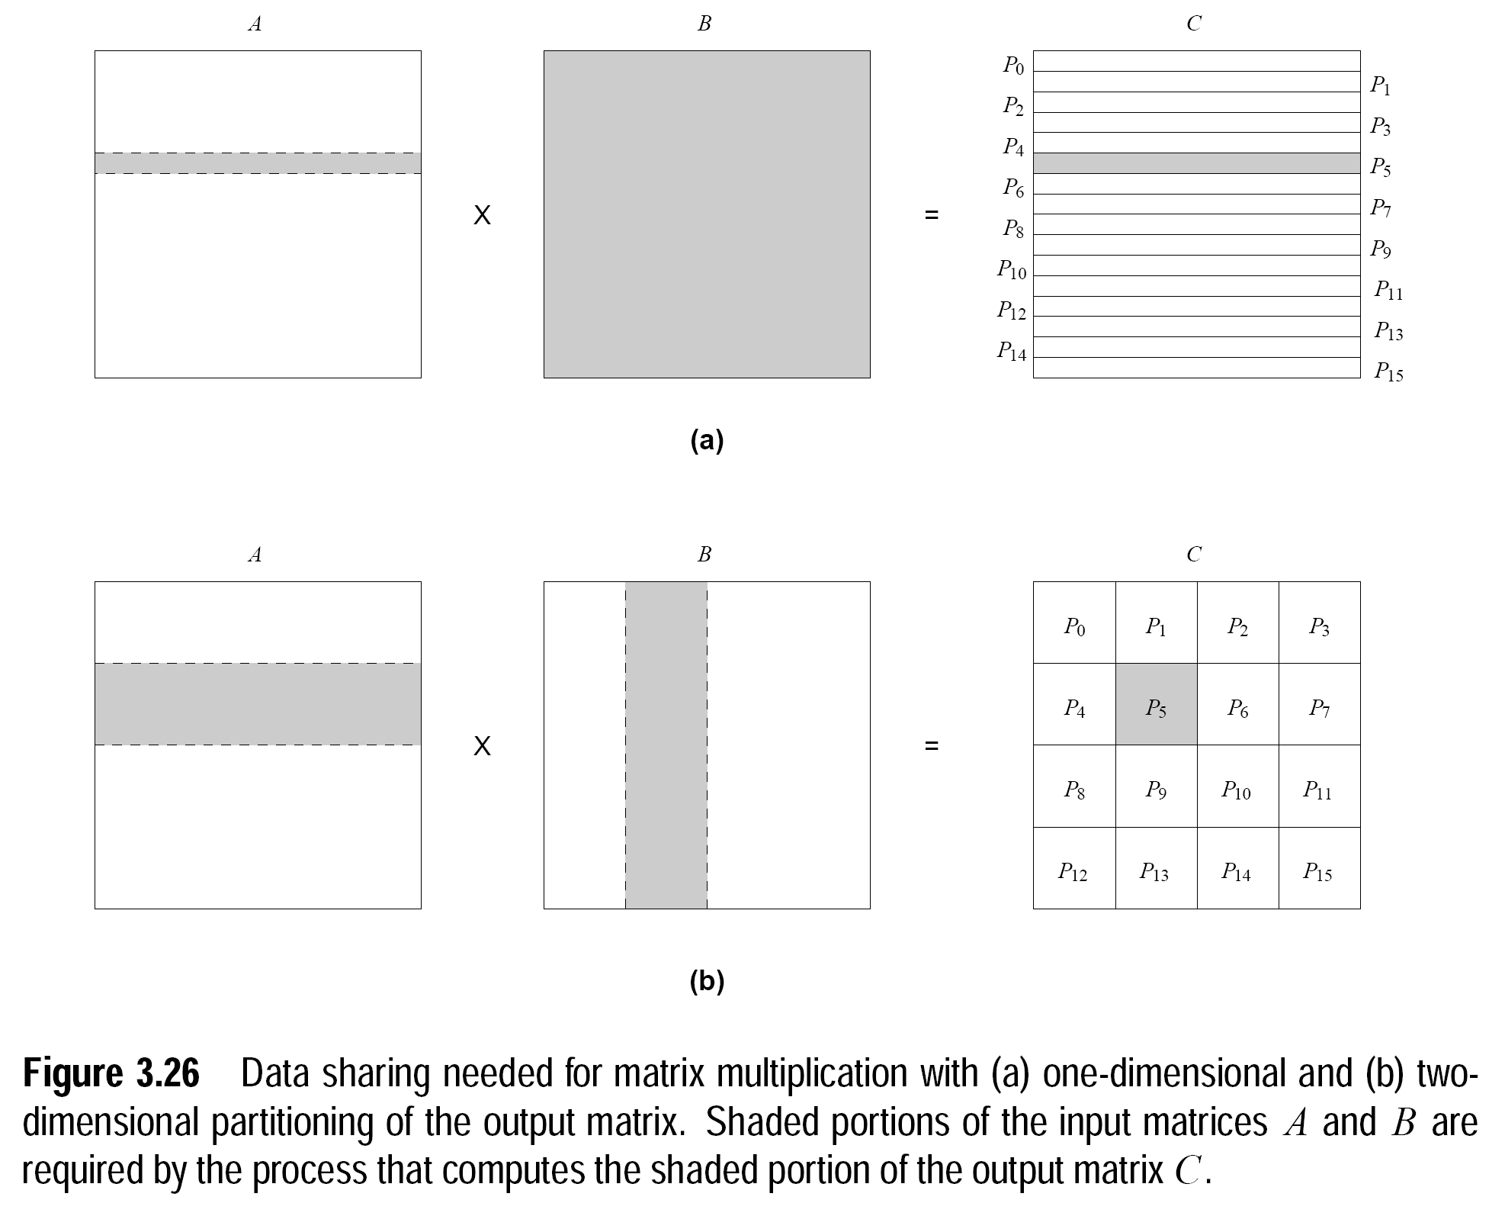
Notes:
Data-load balancing and higher level of fine-graining.

Slide 8
Schemes for Static Mapping (Mappings based on Data Partitioning )
Array Distribution Schemes:
Cyclic distribution (HERE array size=4 x 4 and p=4)
P0 | P1 | P2 | P0
P1 | P2 | P0 | P1
P2 | P0 | P1 | P2
P0 | P1 | P2 | P0
Notes:
Each element of the array is considered as a task and is mapped to all the processes in round robin fashion
Extremely fine-grained distribution
Motive is to reduce the idle time

Slide 9
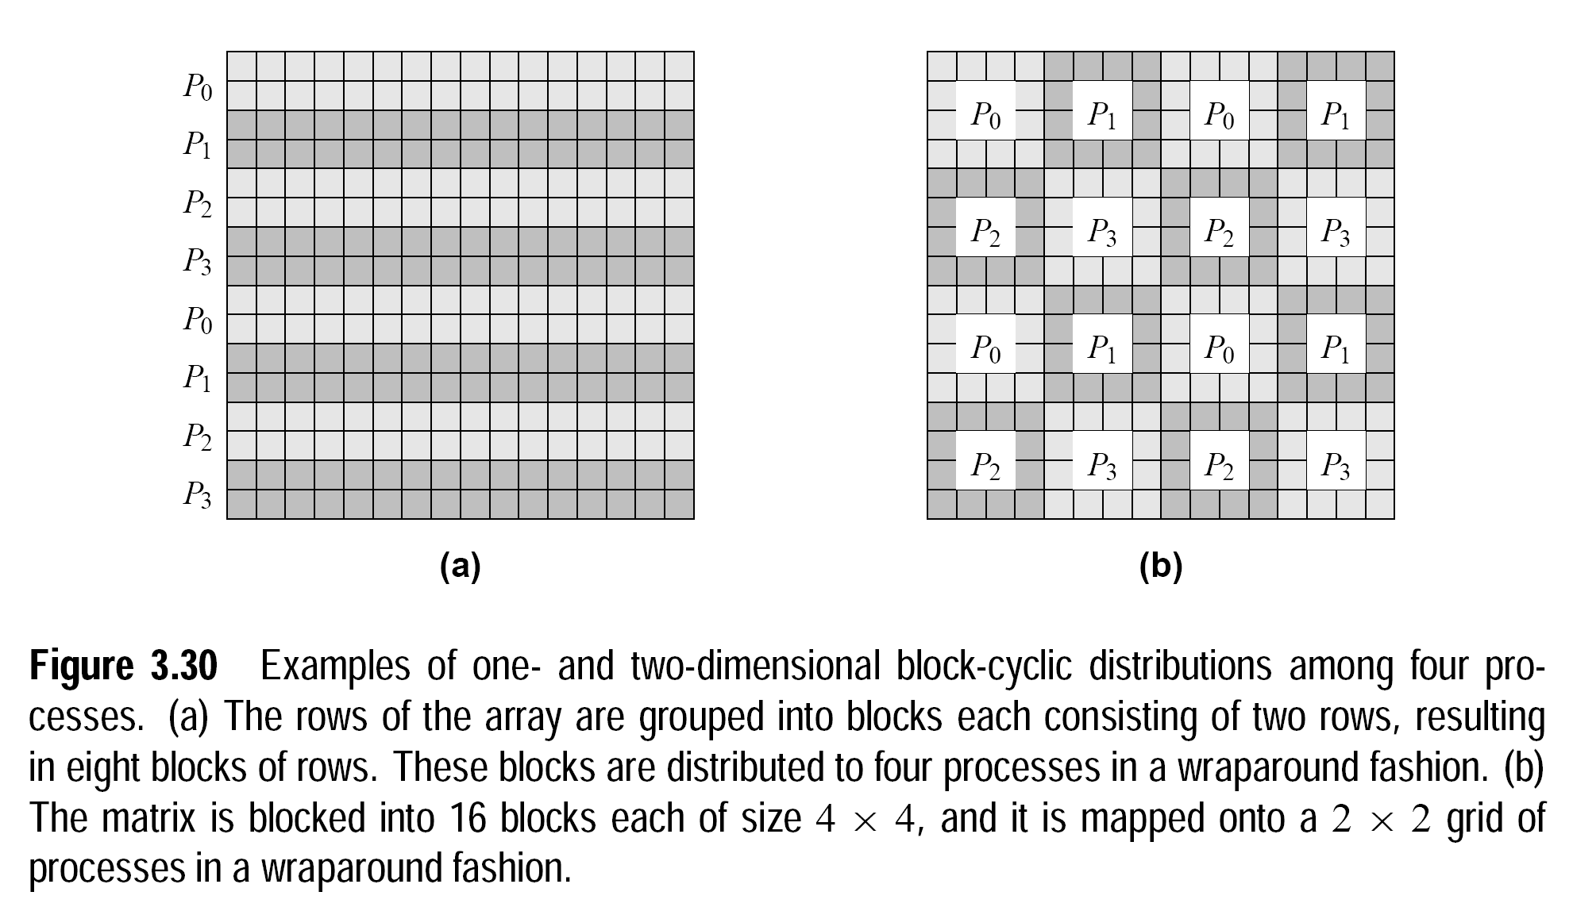
Schemes for Static Mapping (Mappings based on Data Partitioning )
Array Distribution Schemes:
Block-Cyclic distribution (1D and 2D)
Notes:
Difference is that you make large number of small blocks and assign them to the processes in cyclic fashion

Slide 10
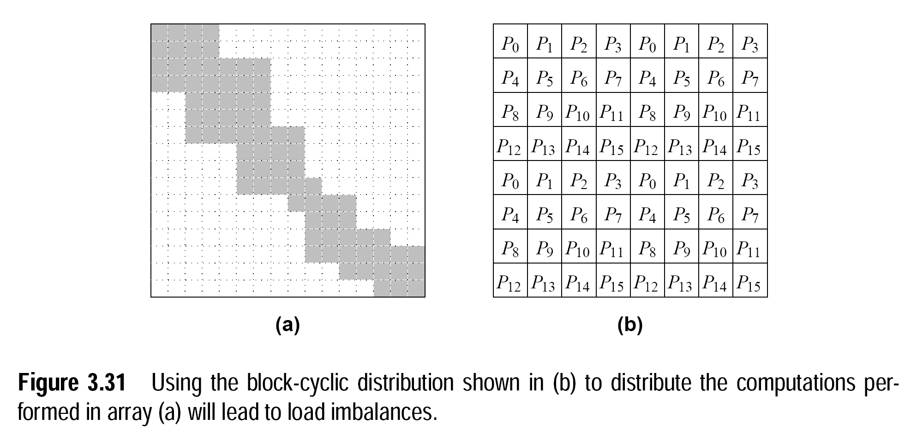
Schemes for Static Mapping (Mappings based on Data Partitioning )
Array Distribution Schemes:
Block-Cyclic distribution (Issue)
Notes:
2d mapping on 16 processes.
Processes on the diagonals shall always have to computes maximal portions.
P12 shall never have to do any thing

Slide 11
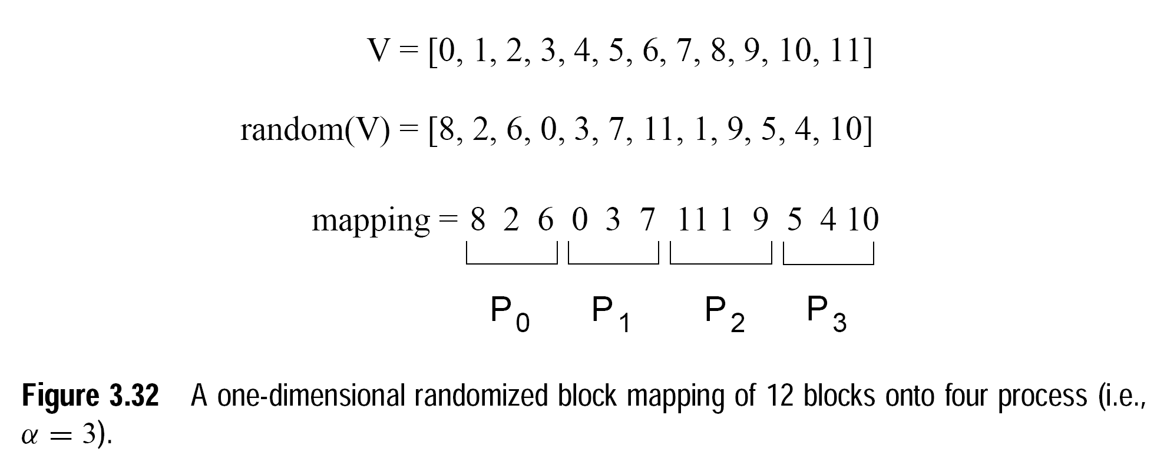
Schemes for Static Mapping (Mappings based on Data Partitioning )
Array Distribution Schemes:
Randomized-Block distribution (solution: 1D)
Notes:
1D-randomized block mapping
1→ Randomly permute set V, then assign block of elements to processes as in block distribution.

Slide 12
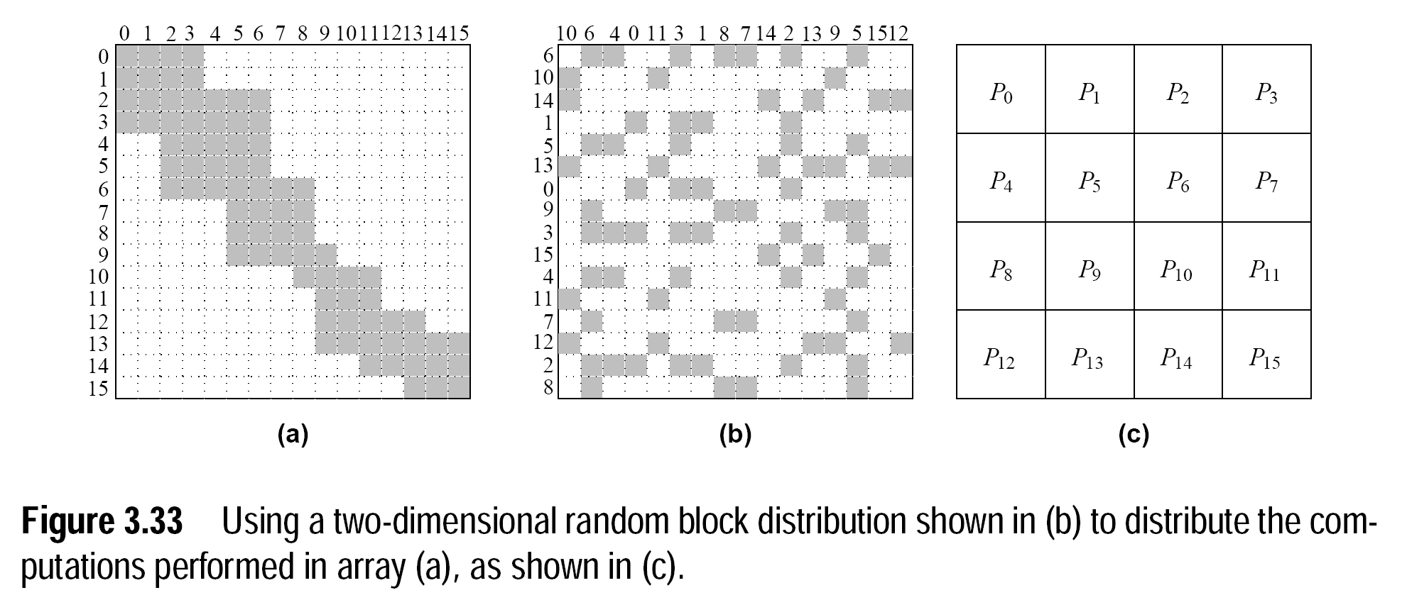
Schemes for Static Mapping (Mappings based on Data Partitioning )
Array Distribution Schemes:
Randomized-Block distribution (solution: 2D)
Notes:
Permute the matrix→ use 2d block distribution

Slide 13
Why randomized bock cyclic distribution is not always used?
Notes:
Poor spatial locality
High inter-process interaction

Slide 14
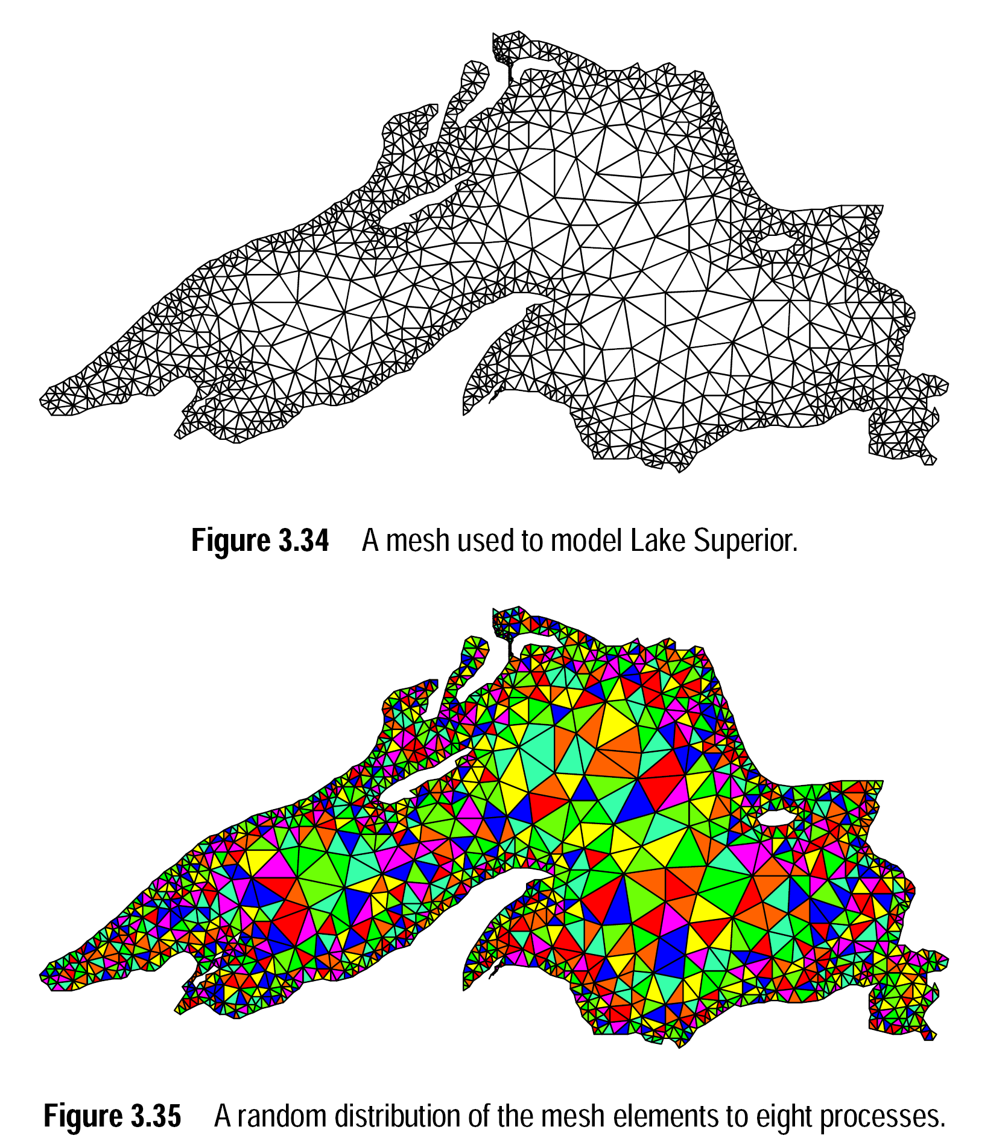
A simulation model (using a mesh of tasks) for finding dispersion of water contaminant in a lake at different intervals of time.
Notes:
Lake Superior is the largest of the Great Lakes of North America,

Slide 15
Notes:
Due lake of locality, each process shall have to communicate with many other processes; resulting in high interaction overheads.

Slide 16
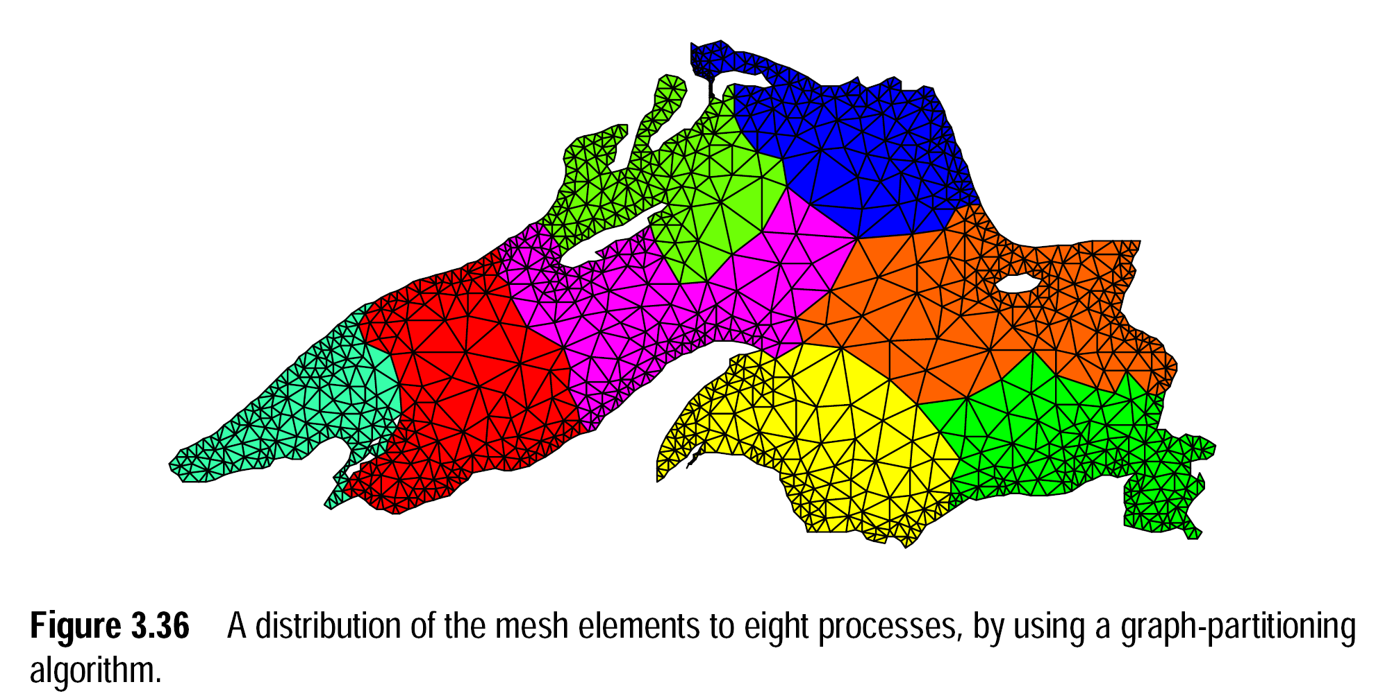
Notes:
A relatively better implementation.

Slide 17

Questions

Slide 18
References
Kumar, V., Grama, A., Gupta, A., & Karypis, G. (1994). Introduction to parallel computing (Vol. 110). Redwood City, CA: Benjamin/Cummings.
Quinn, M. J. Parallel Programming in C with MPI and OpenMP,(2003).

